Slide 1
NAME : SANJAY T
NM ID - au421221243035
FINAL PROJECT: SOFTWARE DEFAULT PREDICTION
MAIL ID – sanjayvelan8@gmail.com

Slide 2


AGENDA
Introduction
Problem Statement
Project Overview
End Users
Solution and Value Proposition
The WOW in Your Solution
Modeling
Results
Conclusion
3/21/2024 Annual Review

Slide 3

PROBLEM STATEMENT
Automated software defaults detection is crucial for identifying errors or inconsistencies within software systems. However, existing methods often lack precision and efficiency, leading to missed issues or false positives. This hampers the reliability and effectiveness of software quality assurance processes. Improving default detection accuracy and speed is imperative for ensuring robust and reliable software performance. Addressing this challenge requires innovative approaches that enhance detection capabilities while minimizing false alarms and optimizing resource utilization.

Slide 4

PROJECT OVERVIEW
Objective: The primary objective of the project is to develop a predictive model for software defaults. This model aims to forecast the likelihood of encountering software defaults or bugs within a given system or application.
Scope: The project will involve gathering historical data on software defects, including their frequency, severity, and associated factors. This data will be used to train machine learning algorithms to predict the occurrence of defaults in new software releases or updates.
Methodology: The project will follow a data-driven approach, involving data collection, preprocessing, feature engineering, model selection, and evaluation. Various machine learning techniques such as classification algorithms, anomaly detection, or time series analysis may be explored to develop the predictive model. Additionally, the model's performance will be assessed using appropriate metrics such as accuracy, precision, recall, and F1-score.

Slide 5

WHO ARE THE END USERS?
Objective: The primary objective of the project is to develop a predictive model for software defaults. This model aims to forecast the likelihood of encountering software defaults or bugs within a given system or application.
Scope: The project will involve gathering historical data on software defects, including their frequency, severity, and associated factors. This data will be used to train machine learning algorithms to predict the occurrence of defaults in new software releases or updates.
Methodology: The project will follow a data-driven approach, involving data collection, preprocessing, feature engineering, model selection, and evaluation. Various machine learning techniques such as classification algorithms, anomaly detection, or time series analysis may be explored to develop the predictive model. Additionally, the model's performance will be assessed using appropriate metrics such as accuracy, precision, recall, and F1-score.
3/21/2024 Annual Review

Slide 6

YOUR SOLUTION AND ITS VALUE PROPOSITION
Machine Learning Model Development: Utilize historical data on software projects, including variables such as project size, complexity, team composition, development methodology, and external factors like market demand and technology trends. Train machine learning models, such as decision trees, random forests, or neural networks, on this data to predict the likelihood of default for new software projects. These models can learn complex patterns and relationships from past project outcomes to make accurate predictions about future project success or failure.
Real-time Risk Assessment: Implement the developed machine learning model into a software platform or tool that can provide real-time risk assessment for ongoing software projects. This platform can continuously monitor project metrics and external factors, updating its predictions as new data becomes available. By identifying potential default risks early in the project lifecycle, stakeholders can take proactive measures to mitigate these risks and increase the chances of project success.
3/21/2024 Annual Review

Slide 7

THE WOW IN YOUR SOLUTION
Advanced Machine Learning Algorithms: Incorporate cutting-edge machine learning algorithms that not only predict defaults but also analyze patterns and behaviors leading to defaults. Implement deep learning models such as recurrent neural networks (RNNs) or convolutional neural networks (CNNs) to capture complex relationships in data. Additionally, consider ensemble methods like Random Forests or Gradient Boosting to improve prediction accuracy.
Real-time Monitoring and Alerts: Integrate real-time monitoring capabilities into your software solution to detect potential defaults as they occur or even before they happen. Utilize streaming data processing frameworks like Apache Kafka or Apache Flink to handle large volumes of data in real-time. Implement alerting systems that notify relevant stakeholders instantly upon detecting anomalous activities or patterns indicative of potential defaults.
Interactive Visualization and Actionable Insights: Develop interactive visualization tools that provide intuitive insights into default prediction models. Utilize technologies like Plotly or D3.js to create dynamic and visually appealing dashboards.
3/21/2024 Annual Review

Slide 8
MODELLING
Feature Selection and Engineering: Identify and select relevant features that may impact software default. These could include technical factors like code complexity, number of bugs, frequency of updates, as well as business factors like customer satisfaction, market trends, and financial health. Additionally, engineering new features through transformations or combinations of existing ones might improve model performance.
Model Selection and Evaluation: Choose appropriate machine learning algorithms for the task, such as decision trees, random forests, support vector machines, or neural networks. Experiment with different models and hyperparameters to find the one that best fits the data and provides the highest predictive accuracy. Use evaluation metrics like accuracy, precision, recall, F1-score, and ROC curves to assess model performance.
Data Preprocessing and Imbalance Handling: Preprocess the data to handle missing values, outliers, and categorical variables. Address class imbalance if present, as software default cases might be rare compared to non-default cases. Techniques like oversampling, undersampling, or using algorithms designed for imbalanced data (e.g., SMOTE) can help mitigate this issue and improve the model's ability to predict defaults accurately.

Slide 9
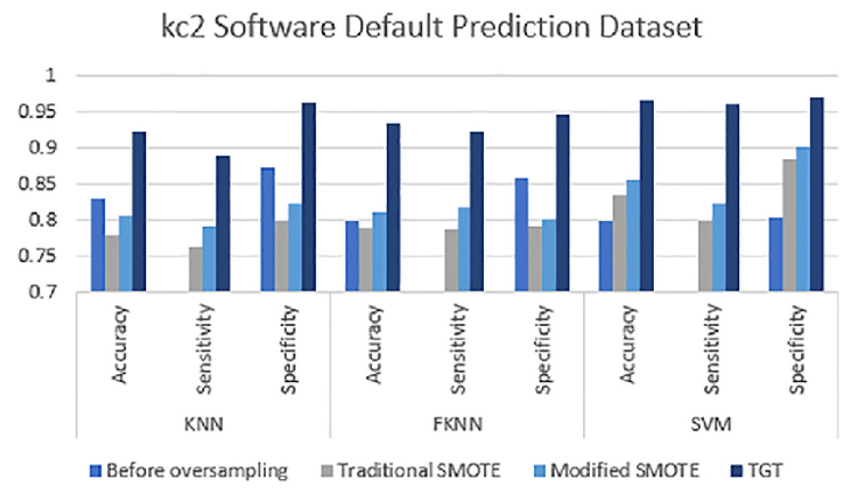
RESULTS

Slide 10
REFERENCES :
"Software Defect Prediction Using Machine Learning Approaches: A Review" by
Muhammad Zubair Asghar et al. – This paper provides an overview of various
machine learning techniques used for software defect prediction.
"Software Defect Prediction Metrics: A Systematic Literature Review" by Indika Perera et al.
This review paper examines various metrics used in software
defect prediction and their effectiveness.

